Slide 1
Human Computer Interaction
HCI Paradigms
Imran Siddiqi
imran.siddiqi@gmail.com

Slide 2
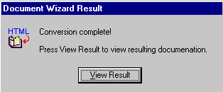
Today’s Interface Hall of Shame
The message appears when generating a Word document from an online help project
Problem
  It's the only option; the user cannot elect to not view the document
Introduction

Slide 3
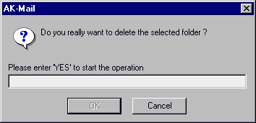
Today’s Interface Hall of Shame
Introduction

Slide 4
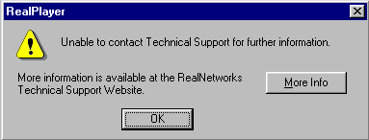
Today’s Interface Hall of Shame
Circular Logic
Introduction

Slide 5
What are Paradigms
A pattern or model, an exemplar in any scientific discipline
A set of practices that define a scientific discipline at any particular period of time
Predominant theoretical frameworks or scientific world views
  E.g. Newtonian and Einsteinian paradigms in physics
Paradigm Shifts
  Change from one way of thinking to another
  From one framework to another ➔ Typically improvement
  Classical mechanics ➔ Quantum Mechanics
Paradigms

Slide 6
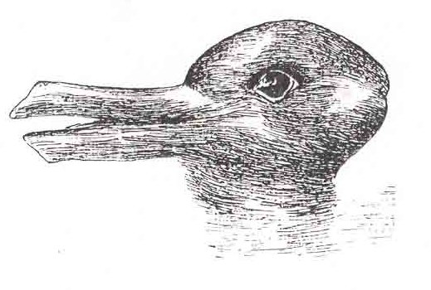
What are Paradigms
Example of Visual Paradigm Shift
Paradigms

Slide 7
Paradigms for Interaction
Investigate some principle historical advances in Interactive Design
Successive interactive systems are commonly believed to enhance usability
New computing technologies arrive, creating a new perception of the human—computer relationship
Paradigms

Slide 8

The Initial Paradigm
Batch Processing
Impersonal computing
Paradigms

Slide 9
Example Paradigm Shifts
Batch Processing
Time Sharing
Interactive computing
Paradigms

Slide 10
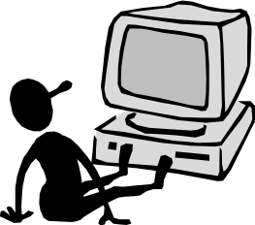
Example Paradigm Shifts
Batch Processing
Time Sharing
Networking
@#$% !
???
Community computing
Paradigms

Slide 11
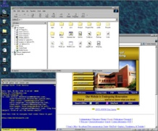
Example Paradigm Shifts
Batch Processing
Time Sharing
Networking
Graphical Displays
Move this file here,
and copy this to there.
C…P… filename
dot star… or was
it R…M?
% foo.bar
ABORT
dumby!!!
Direct manipulation
Paradigms

Slide 12
Example Paradigm Shifts
Batch Processing
Time Sharing
Networking
Graphical Displays
Microprocessor
Personal computing
Paradigms

Slide 13
Example Paradigm Shifts
Batch Processing
Time Sharing
Networking
Graphical Displays
Microprocessor
WWW
Global information
Paradigms

Slide 14

Example Paradigm Shifts
Batch Processing
Time Sharing
Networking
Graphical Displays
Microprocessor
WWW
Ubiquitous Computing
A symbiosis of physical and electronic worlds in service of everyday activities
Paradigms

Slide 15
Batch Processing
1950s – 1960s
Computers first appeared onto the commercial scene
Often run in “batch-mode”
Jobs were submitted on punched cards or tape to a computer operator who would then run them individually on the computer
Difficult to use, cumbersome, and Unpredictable
Paradigms

Slide 16
Time Sharing
Appeared in 1960s
  E.g. IBM 360, SDS 940, PDP-10
Sharing computing resource among many programs/users
Schedule which task may be the one running at any given time via user interrupt
Earliest systems that supported truly interactive exchange between operators and computers
Paradigms

Slide 17
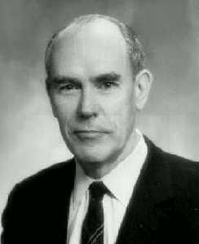
Video Display Units
More suitable medium than paper
Originated in the Mid 1950s
Sketchpad (Ivan Sutherland, 1962)
  Allowed a computer operator to use the computer to create, very rapidly, sophisticated visual models on a display screen that resembled a television set
  Computers for visualizing and manipulating data
Ivan Sutherland
Paradigms

Slide 18
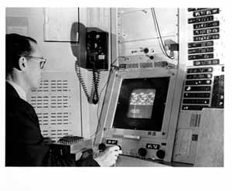
Video Display Units
Sutherland’s Sketchpad
Paradigms

Slide 19
Personal Computing
Emergence of computing power aimed at masses in 1970s
Tools for computer novices: LOGO
  Language for simple graphics programming by children
  A computer-controlled mechanical turtle that drags a pen along a surface to trace its path
  Children can easily direct the turtle to trace out simple geometric shapes and teach the turtle to draw more complicated figures
Future of computing in small, powerful machines dedicated to the individual
Paradigms

Slide 20
Window Interface & WIMP Systems
Window
  A visual area (usually rectangular), containing a user interface which displays output and allows input
  Enable a single user to be engaged in multiple tasks which are separated physically in one computer screen
  Usually associated with graphic displays where they can be manipulated with a pointing device
WIMP
  “Window, Icon, Menu, Pointing device", denoting a style of interaction using these elements
Paradigms

Slide 21
The Metaphor
What is a metaphor?
A metaphor is an analogy between two objects or ideas
A metaphor is the expression of an understanding of one concept in terms of another concept, where there is some similarity or correlation between the two
Example (English)
  All the world’s a stage, And all the men and women merely players; They have their exits and their entrances
Paradigms

Slide 22

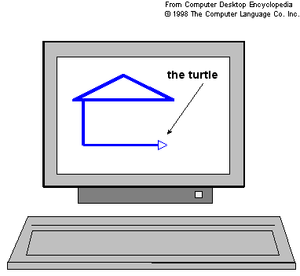
The Metaphor
Easy to comprehend
Relating computing to other real-world activity is effective teaching technique
  LOGO's turtle dragging its tail
  File management on an office desktop
  Word processing as typing
Paradigms

Slide 23


The Metaphor - Issues
Some of the tasks we perform with a computer do not have real-world equivalents or a single metaphor cannot account for all of them
  E.g. There is no office equivalent for ejecting a floppy disk, and it is not intuitive to drag the icon of a floppy disk to the wastebasket metaphor in order to eject from the system
Interpretation of a metaphor can be affected by culture
  E.g. Things thrown into a trashcan are recoverable in some countries, but they are gone for good in other countries
Paradigms

Slide 24
Direct Manipulation
A term coined to describe the graphics-based interactive systems (Ben Shneiderman, 1982)
Important Features:
  Visibility of the objects of interest
    E.g. Documents and folders are made visible to the user as icons which represent the underlying files and directories, respectively
  Incremental action at the interface with rapid feedback on all actions
    E.g. The operation of moving a file from one directory to another is mirrored as an action on the visible document which is “picked up and dragged” along the desktop from one folder to another
Paradigms

Slide 25
Direct Manipulation
Important Features (Contd…)
  Reversibility of all actions, so that users are encouraged to explore without severe penalties
    E.g. If the user moves a document to a wrong place, it is relatively easy to detect and recover from the error
  Syntactic correctness of all actions, so that every action is a legal operation
    E.g. It is impossible for formulate a syntactically incorrect move operation with the pick-up-and-drag style of command (Mistype filename)
  Replacement of complex command language with actions to manipulate directly the visible objects
Paradigms

Slide 26
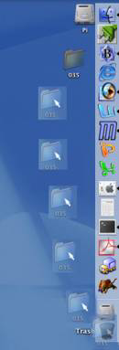
Direct Manipulation
“Trash” on the Desktop
  An excellent example of direct manipulation
  Users can see both the trash and the files or folders they want to move to the trash
  They then physically select the files and drag them to the trash can
  While the user is doing this, all of the selected files move as well, illustrating which items the user has selected
  When the mouse is placed over the trash, there is a shading indication that it has been selected
Paradigms

Slide 27
Direct Manipulation
“Trash” on the Desktop (Contd…)
  The user then has to release the mouse button to move the files to the trash
  If there are many files, a dialogue box will show up illustrating the progress of moving files to the trash
  Once the action is completed, the files are no longer visible in their original location
  The user can change his mind at any time while dragging the files to the trash
  Even after placing them there, they can as easily be taken out of the trash and put back in place
Paradigms

Slide 28
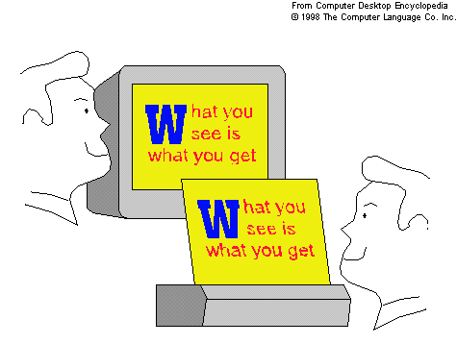
WYSIWYG
What You see is What You Get (WYSIWYG)
Related to the visualization provided by direct manipulation
Describes a user interface in which representation during editing appears very similar to that in the final product
  E.g. word processors, web (HTML) development
The simplicity and immediacy of the mapping between representation and final product are main concerns
Paradigms

Slide 29
WYSIWYG
It is not a criterion for usability
  It is difficult to achieve complex design if you must always see the results on screen
  Word Processor – Picture in a Document
  Requirement: Top of the page on which it is first referenced
  Changes to the document – Picture position changes
    Make adjustments to the picture
    Use directive – Sacrifice WYSIWYG
Paradigms

Slide 30
Hypertext
Hypertext
  Deal with information overload issue in scientific knowledge
  Describes a way of organizing material that attempts to overcome the inherent limitations of traditional text and in particular its linearity
  Contains automated cross-references to other documents called hyperlinks
Hypermedia
  An extension of hypertext, in which graphics, audio, video, plain text and hyperlinks intertwine
Paradigms

Slide 31
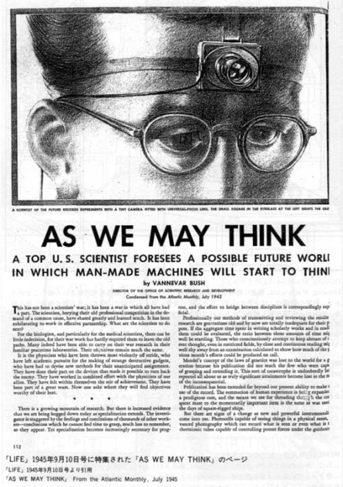
Hypertext
Vannevar Bush’s article “As We May Think“ (1945)
  An innovative futuristic information storage and retrieval device called a “Memex”
  Memex is a device in which an individual stores all of their books and records which may then be consulted with exceeding speed and flexibility. A document can be given a simple numerical code that allows the user to access it after dialing the number combination
Paradigms

Slide 32
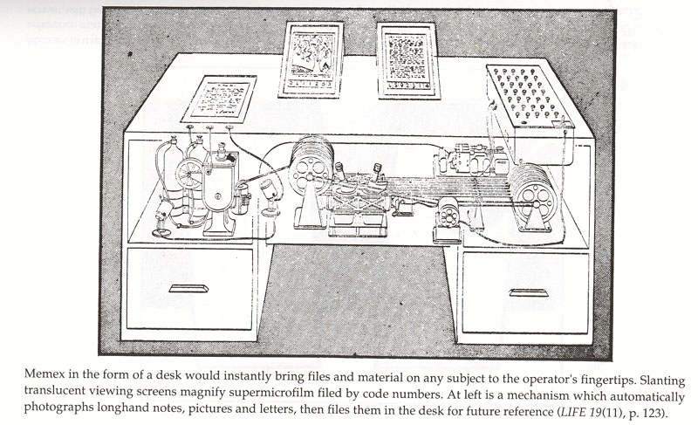
Hypertext
Memex
Paradigms

Slide 33
Multi-Modality
Modality
  A sense through which the human can receive the output of the computer
    For example vision modality
  A sensor or device through which the computer can receive the input from the human
Multi-Modal Systems
  Provide the user with multiple modes of interfacing with a system
  Increased usability by combining the strengths of different communication channels
    All interactive systems can be considered multi-modal - Visual + Touch
Paradigms

Slide 34
Computer-Supported Cooperative Work
Computer Networks – Communication between separate machines
  No longer single user / single computer system
  How to support collaborative activities and their coordination by means of computer systems – CSCW
Groupware
  CSCW tools built to support users working in groups
  E.g. Electronic mail (email) by which individuals at physically separate locations can communicate electronically
Paradigms

Slide 35
Computer-Supported Cooperative Work
Asynchronous Collaboration
  The participants do not have to be working at the same time
  E.g. Email
Synchronous Collaboration
  Interactions among participants happen at near-real-time
  E.g. instant message, electronic whiteboard
Paradigms

Slide 36
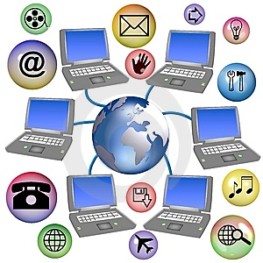
World Wide Web
The Web, is a system of interlinked hypertext documents contained on the Internet.
Most significant (recent) development in interactive computing.
Communicate using common transmission protocols (TCP/IP).
Simple, universal protocols (e.g. HTTP) and mark-up languages (e.g. HTML) made publishing and accessing easy
Paradigms

Slide 37
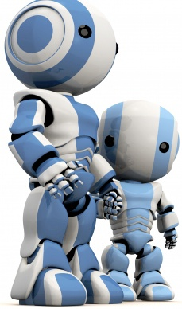
Agent-based Interfaces
Human Agents
  Agents work on someone’s behalf – estate agents, travel agents
Software Agent
  A piece of software that carries out some set of operations on behalf of a user or another program with some degree of independence or autonomy
  E.g. email agents that filter spam for you, web crawlers which search the internet for documents you might find interesting
  Some agents simple use if then rules
  Others may use Artificial Intelligence techniques to learn based on user actions
Paradigms

Slide 38
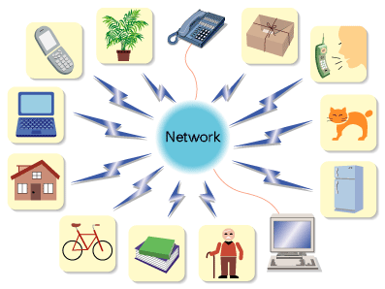
Ubiquitous Computing (Pervasive Computing)
Post-Desktop Model of computing
Computer – Very apparent
How to make it disappear?
  Shrink and embed/distribute it in the physical world
Information processing – integrated into everyday objects and activities
Paradigms

Slide 39
Ubiquitous Computing
Mainframe
  Many people share one computer
Personal Computer
  One person with one computer
Ubiquitous Computing
  Many computers serve one person
Paradigms

Slide 40
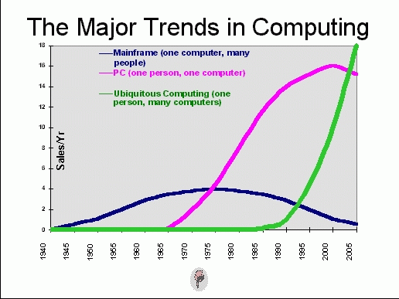
Ubiquitous Computing
Paradigms

Slide 41
Ubiquitous Computing – Three Scales of Computing Technology
Yard-size
  Suitable for wide open public spaces and shared by a group of people
  E.g. High-resolution large screens and project displays
Foot-size
  Much like today’s personal computer
  Suitable for every individual to have one
  E.g. Laptop, desktop, tablet computer
Inch-size
  A computing device that can fit in the palm of a hand
  Everyone would have a number of these at their disposal
  E.g. PDA, electronic dictionary, cell phone
Paradigms

Slide 42
Ubiquitous Computing - Sensor-Based and Context-Aware Interaction
An extreme case of ubiquitous computing in which the user is totally unaware of the interactions that are taking place
Sensors in the environment
  E.g. Automatic lights, smoke detectors etc.
Sensors in our information world
  E.g. Websites visited, time spent online, books purchased etc.
Sensors in our bodies
  E.g. Heart rate, skin temperature, brain signal etc.
Information from sensors is used by systems to make inferences about our past patterns and current context in order to modify the explicit interfaces we deal with
Paradigms

Slide 43

References
Chapter 4 - Human Computer Interaction by Dix et al.
HCI Paradigms and User Centred Design, Yan Liu, Wright State University
User Interface Hall of Fame/Shame
Paradigms

